Slide 1

Spark Streaming

Slide 2
What is Spark Streaming?
Core feature of Spark.
Extension of Spark Core API that allows real-time data processing.
Processed data can be saved in file systems, databases, etc.

Slide 3
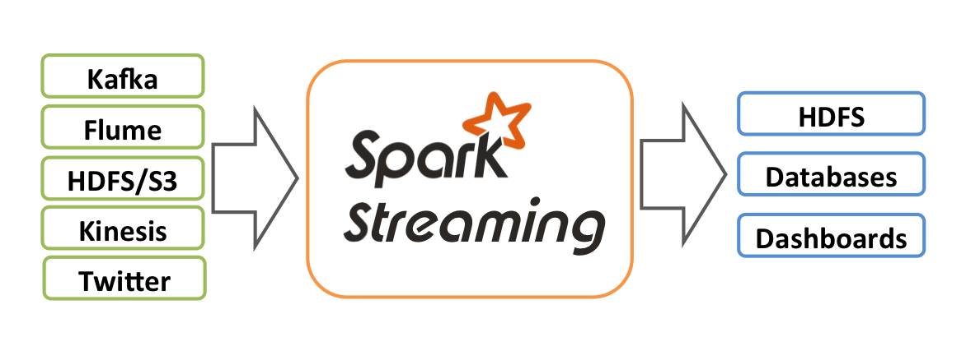
Data Sources
Data Storage

Slide 4
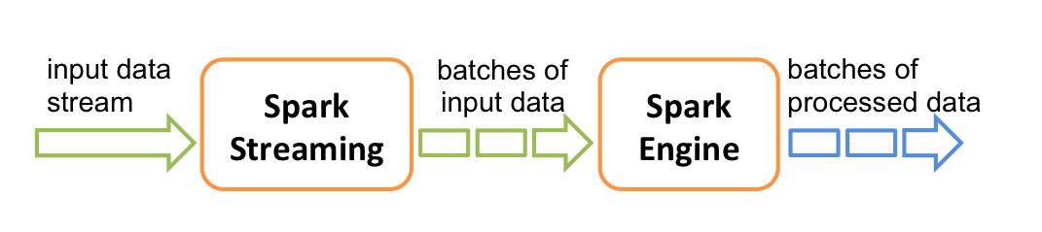

Slide 5

Discretized Streams (DStreams)
Discretized Stream or DStream is the basic abstraction provided by Spark Streaming. It represents a continuous stream of data, either the input data stream received from source, or the processed data stream generated by transforming the input stream. Internally, a DStream is represented by a continuous series of RDDs, which is Spark’s abstraction of an immutable, distributed dataset (see Spark Programming Guide for more details). Each RDD in a DStream contains data from a certain interval, as shown in the following figure.

Slide 6
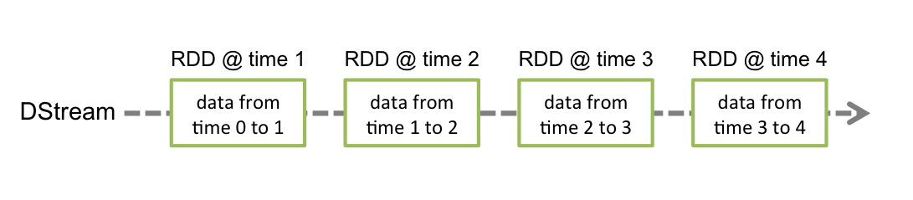

Slide 7
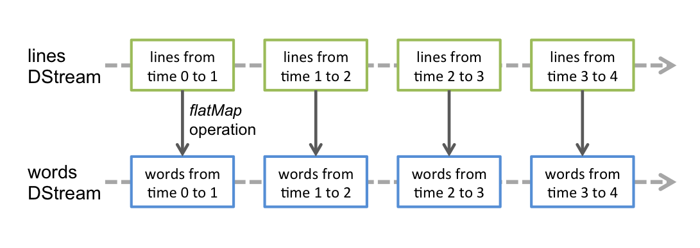

Slide 8
Structured Streaming
A feature released with Spark 2.2.
Perform the same operations as in batch processing and use them for streaming purposes.
Allows incremental processing.
Saves new data appended to an unbounded table.

Slide 9
